Slide 1
AWS Beanstalk & CloudFormation
——Leson
We are Capability Center,Let's Work Together!

Slide 2

目录
CONTENTS
01 What Is AWS Elastic Beanstalk?
02 What is AWS CloudFormation?

Slide 3
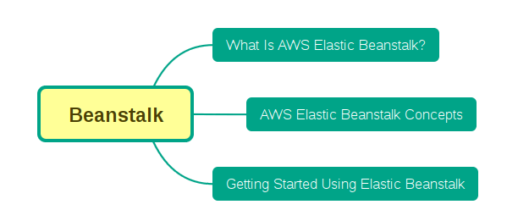
Beanstalk Contents

Slide 4
Why Beanstalk?
Amazon Web Services (AWS) comprises dozens of services, each of which exposes an area of functionality.
While the variety of services offers flexibility for how you want to manage your AWS infrastructure, it can be challenging to figure out which services to use and how to provision them.

Slide 5
Beanstalk Benefit
With Elastic Beanstalk, you can quickly deploy and manage applications in the AWS Cloud without worrying about the infrastructure that runs those applications.
AWS Elastic Beanstalk reduces management complexity without restricting choice or control.
You simply upload your application, and Elastic Beanstalk automatically handles the details of capacity provisioning, load balancing, scaling, and application health monitoring.
Elastic Beanstalk uses highly reliable and scalable services that are available in the AWS Free Tier.

Slide 6
Beanstalk Provide
Elastic Beanstalk supports applications developed in Java, PHP, .NET, Node.js, Python, and Ruby, as well as different container types for each language.
A container defines the infrastructure and software stack to be used for a given environment.
When you deploy your application, Elastic Beanstalk provisions one or more AWS resources, such as Amazon EC2 instances.
The software stack that runs on your Amazon EC2 instances depends on the container type.
For example, Elastic Beanstalk supports two container types for Node.js: a 32-bit Amazon Linux image and a 64-bit Amazon Linux image. Each runs a software stack tailored to hosting a Node.js application. You can interact with Elastic Beanstalk by using the AWS Management Console, the AWS Command Line Interface (AWS CLI), or eb, a high-level CLI designed specifically for Elastic Beanstalk.

Slide 7
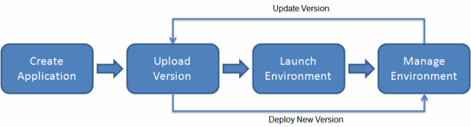
Beanstalk Workflow

Slide 8
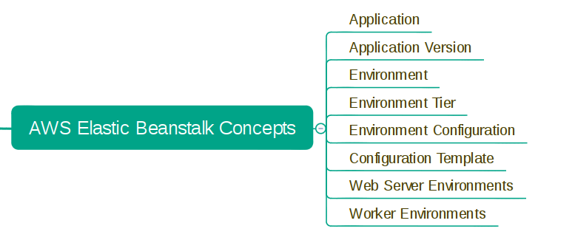
Beanstalk Concepts

Slide 9
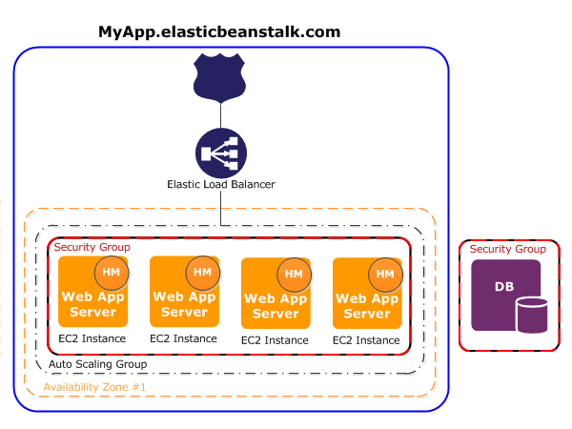
Beanstalk Web Server Environments
This following diagram illustrates an example Elastic Beanstalk architecture for a web server environment tier and shows how the components in that type of environment tier work together. The remainder of this section discusses all the components in more detail.

Slide 10
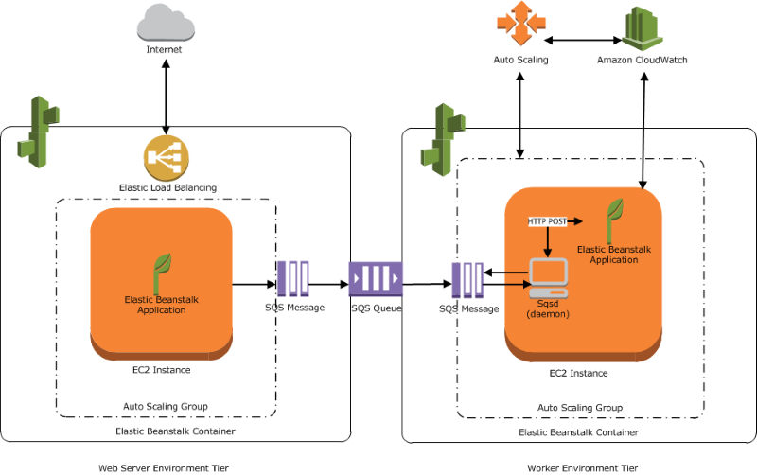
Beanstalk Worker Environments
The following diagram shows the different components and their interactions across environments and AWS services.
Notes:
The following diagram shows the different components and their interactions across environments and AWS services.

Slide 11
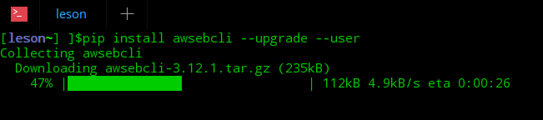
Beanstalk CLI
pip install awsebcli --upgrade --user

Slide 12
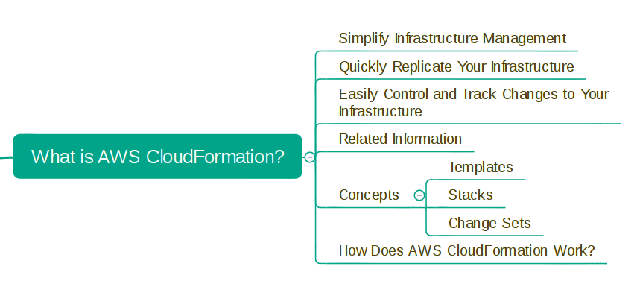
CloudFormation

Slide 13
CloudFormation Instruction
AWS CloudFormation is a service that helps you model and set up your Amazon Web Services resources so that you can spend less time managing those resources and more time focusing on your applications that run in AWS.
You create a template that describes all the AWS resources that you want (like Amazon EC2 instances or Amazon RDS DB instances), and AWS CloudFormation takes care of provisioning and configuring those resources for you.
You don't need to individually create and configure AWS resources and figure out what's dependent on what; AWS CloudFormation handles all of that.

Slide 14
CloudFormation Features
Simplify Infrastructure Management
Quickly Replicate Your Infrastructure
Easily Control and Track Changes to Your Infrastructure

Slide 15
AWS CloudFormation Concepts
When you use AWS CloudFormation, you work with templates and stacks. You create templates to describe your AWS resources and their properties. Whenever you create a stack, AWS CloudFormation provisions the resources that are described in your template.
Topics
Templates
Stacks
Change Sets

Slide 16
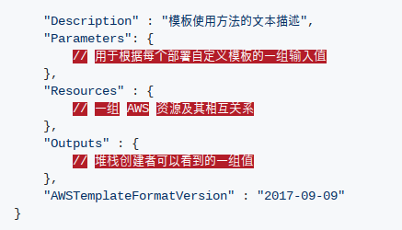
CloudFormation Templates

Slide 17
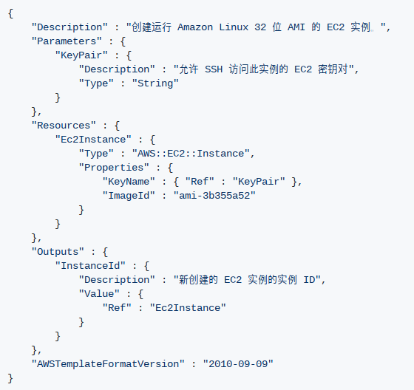
CloudFormation Templates

Slide 18
CloudFormation Stacks
When you use AWS CloudFormation, you manage related resources as a single unit called a stack.
You create, update, and delete a collection of resources by creating, updating, and deleting stacks.
All the resources in a stack are defined by the stack's AWS CloudFormation template.

Slide 19
CloudFormation Change Sets
If you need to make changes to the running resources in a stack, you update the stack.
Before making changes to your resources, you can generate a change set, which is summary of your proposed changes.
Change sets allow you to see how your changes might impact your running resources, especially for critical resources, before implementing them.

Slide 20
Thank you
——Leson

